Slide 1


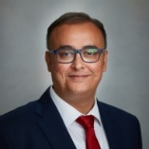
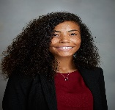
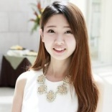
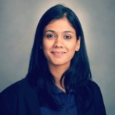
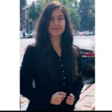
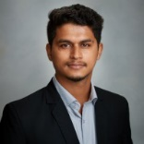
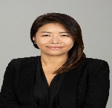
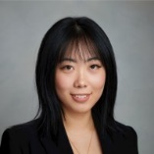
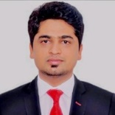

About Us
Marshall Global Supply Chain Club (GSCC) serves as advocates for full-time GSCM students to the administration and faculty. We collaborate with a variety of groups within Marshall and USC, including the Center for Global Supply Chain Office, Career Resource Center (CRC), Graduate Student Government (GSG), and Marshall student-led organizations.
Through forums and open communication with full-time and online classmates, we identify key areas for improvement within the Marshall community and implement changes to move the program forward and improve the future and wellness of Marshall.
GSCC Board
    Prateek Mahadik
    President
    Prateek.Mahadik.2020@marshall.usc.edu
    Kristina Hintzen
    VP of Industry Outreach
    Kristina.Hintzen.2020@marshall.usc.edu
Danielle Zhou
VP of Alumni Relations
Danielle.Zhou.2020@marshall.usc.edu
Rashi Bagadia
VP of Finance
Rashi.Bagadia.2020@marshall.usc.edu
Aditi Bhonsle
VP of Student Affairs (On-campus)
Aditi.Bhonsle.2020@marshall.usc.edu
Vikram Golcha
VP of Administration
Vikram.Golchha.2020@marshall.usc.edu
Joan Oh
VP of Student Affairs (Online)
HyunJung.Oh.2020@marshall.usc.edu
Xin Li (Kaylee)
VP of Events
Xin.li.2020@marshall.usc.edu
Manoj Aggarwal
VP of Communications
Manoj.Aggarwal.2020@marshall.usc.edu
Contact Us
Feel free to reach out to any of our board members for more information about GSCC’s role or leadership positions within Marshall.
Get Involved – Be a Core Rep!
First year students interested in getting involved in the fall semester can apply to be core representatives in the following areas:
Alumni Relations,
Industry Outreach, Finance, Student Affairs, Events, Administration, Communications
Core Rep positions will be appointed
in the Fall for the Class of 2021.
Elections for GSCC are held at
the start of the Fall Semester 2020.
http://clubs.marshall.usc.edu/mgsa.ft

Slide 2
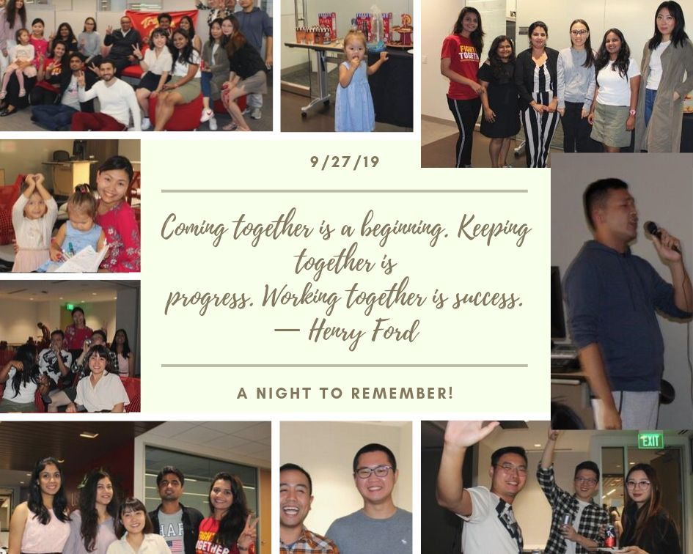
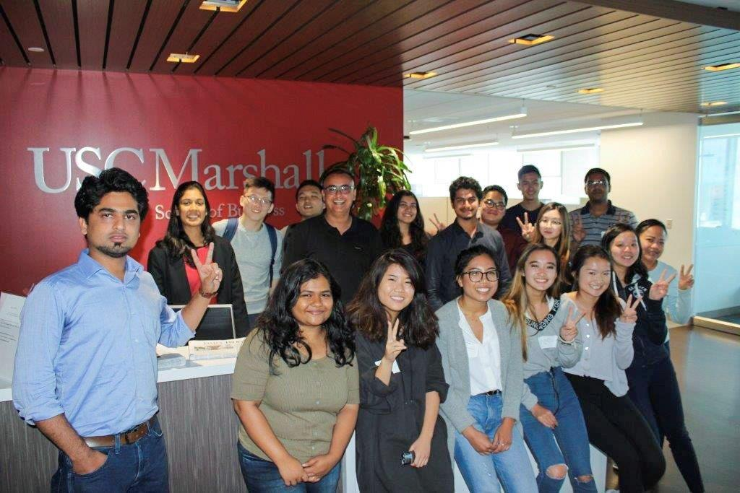
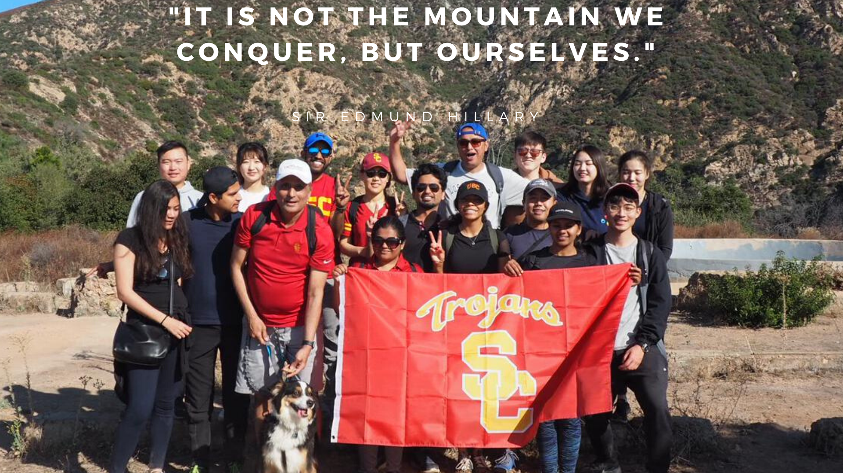
Past Events

